Slide 1
EudraCT Safety Data Tool
6th April 2020
Simon Bond, Cambridge CTU

Slide 2
Outline
Input Data
Output Statistics
Interactive examples using R/SAS/Stata
XML generation and transformation
Upload

Slide 3
Requirements
Laptop
Choice of Stats software:
R, SAS, Stata
Download from
http://eudract-tool.medschl.cam.ac.uk
Access to the EudraCT Training environment
https://eudract-training.ema.europa.eu/results-web/login/login.xhtml

Slide 4
Input
Each row is one adverse event
(SAE is a subset of AE for this talk)
Numbers exposed in each group
(group = arm= treatment=…)
In case some patients are event-free.
Counts of deaths not recorded in the data !

Slide 5
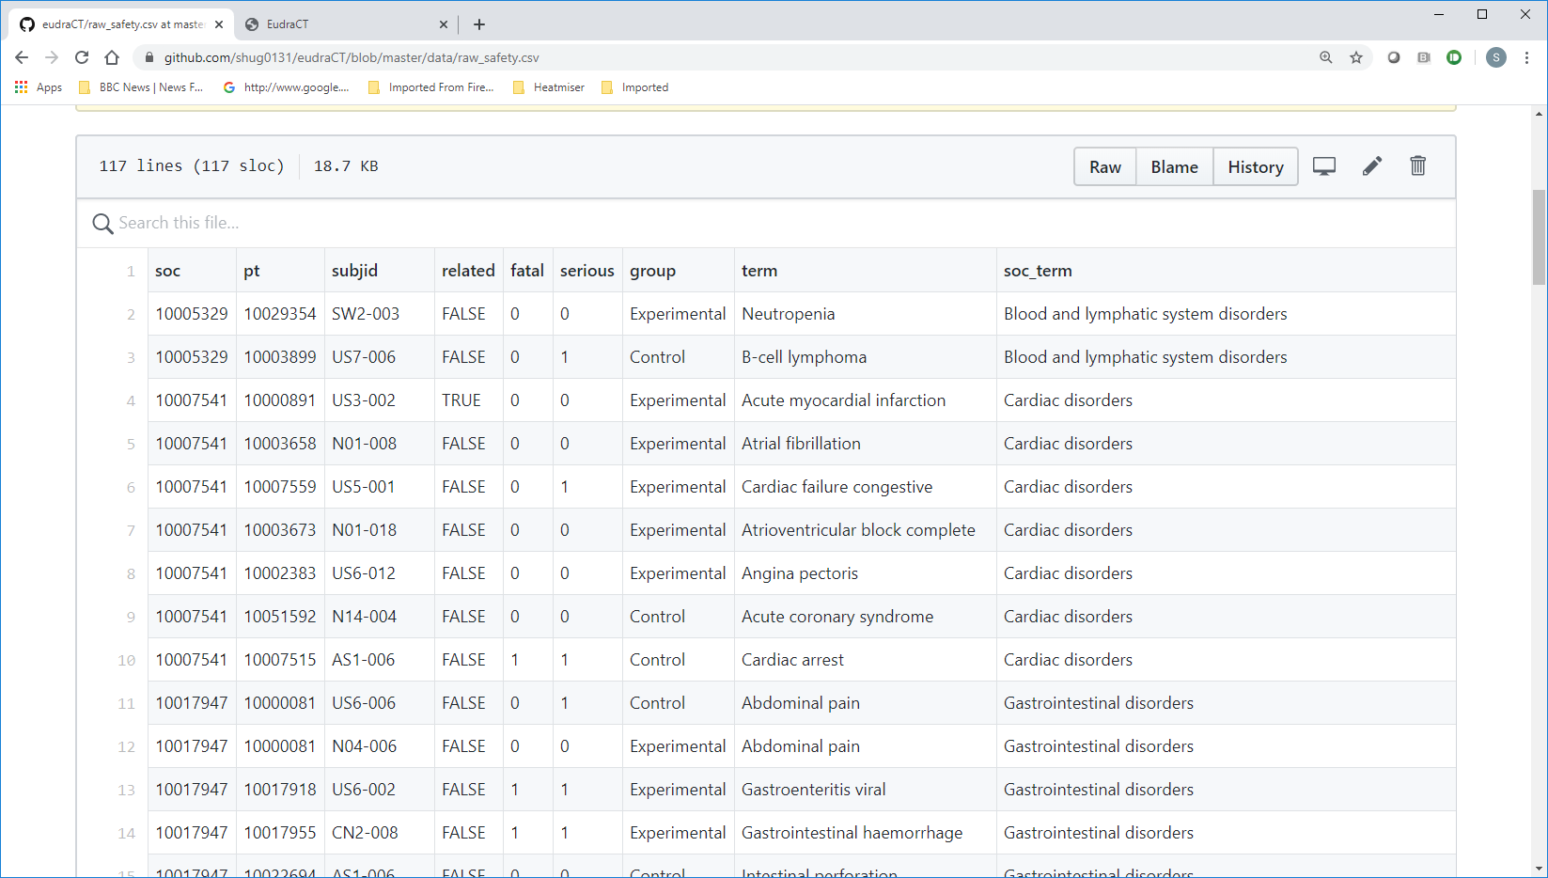

Slide 6
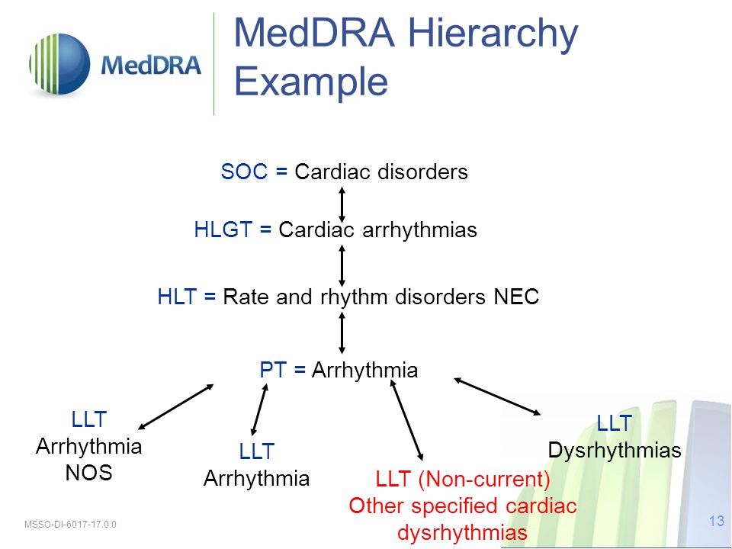
MedDRA
Each Preferred Term (PT) has a Primary SOC, but may have other secondary options.
Not a strict 1-Many hierarchy

Slide 7
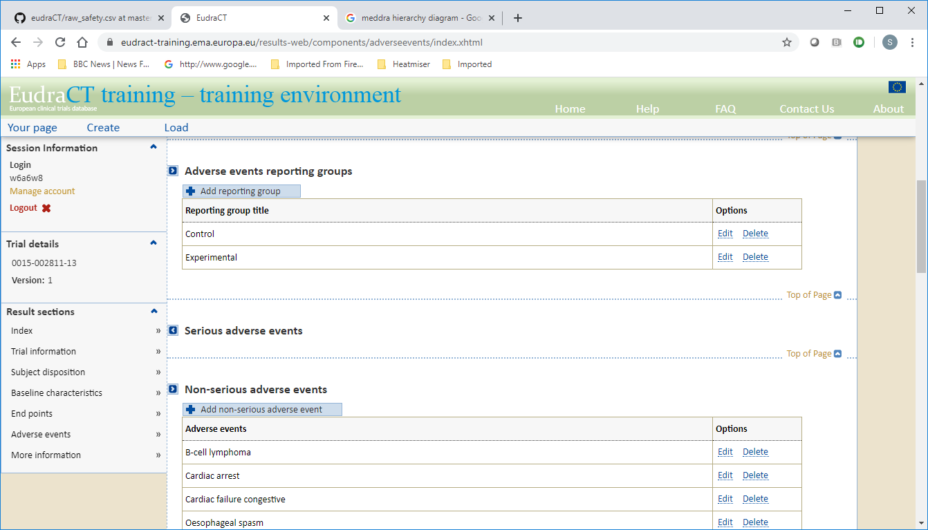
Output – Top level

Slide 8
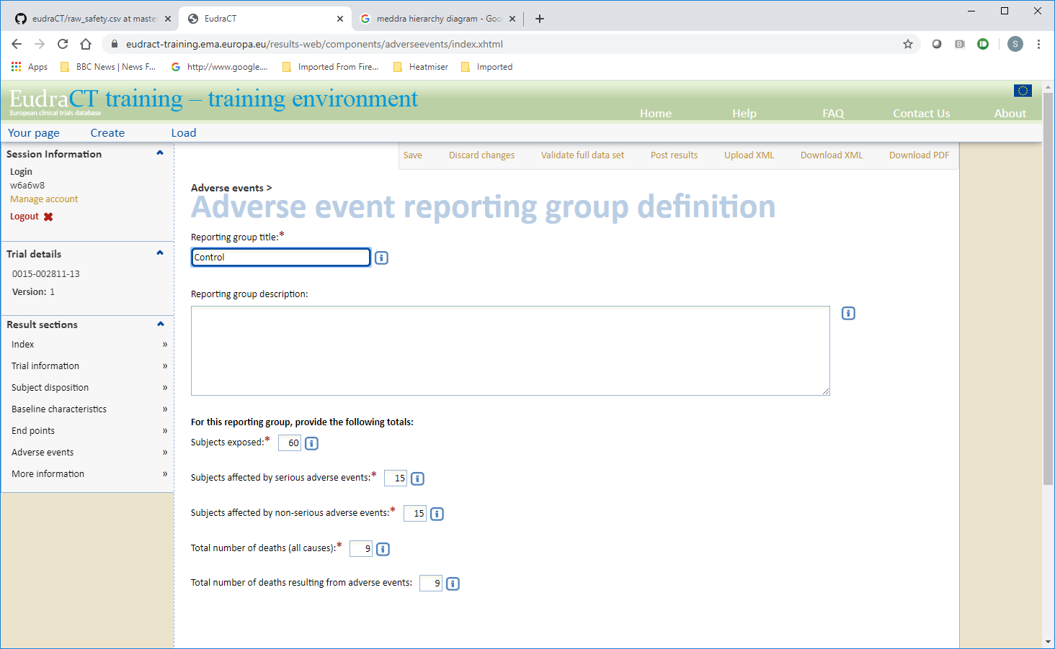
Output – Group Level

Slide 9
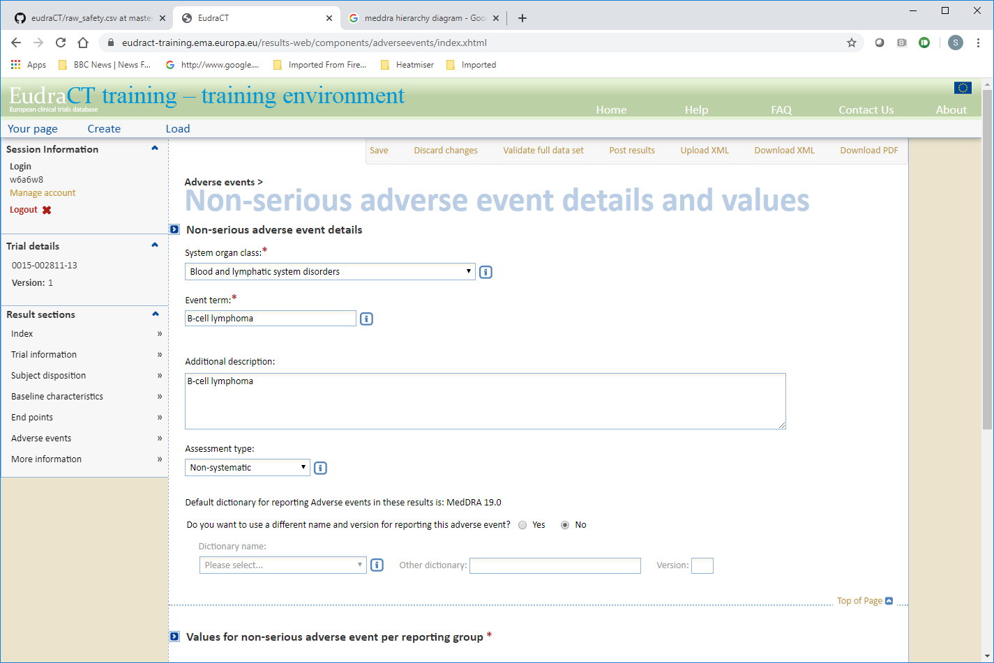
Output – Non Serious AE (part 1)

Slide 10
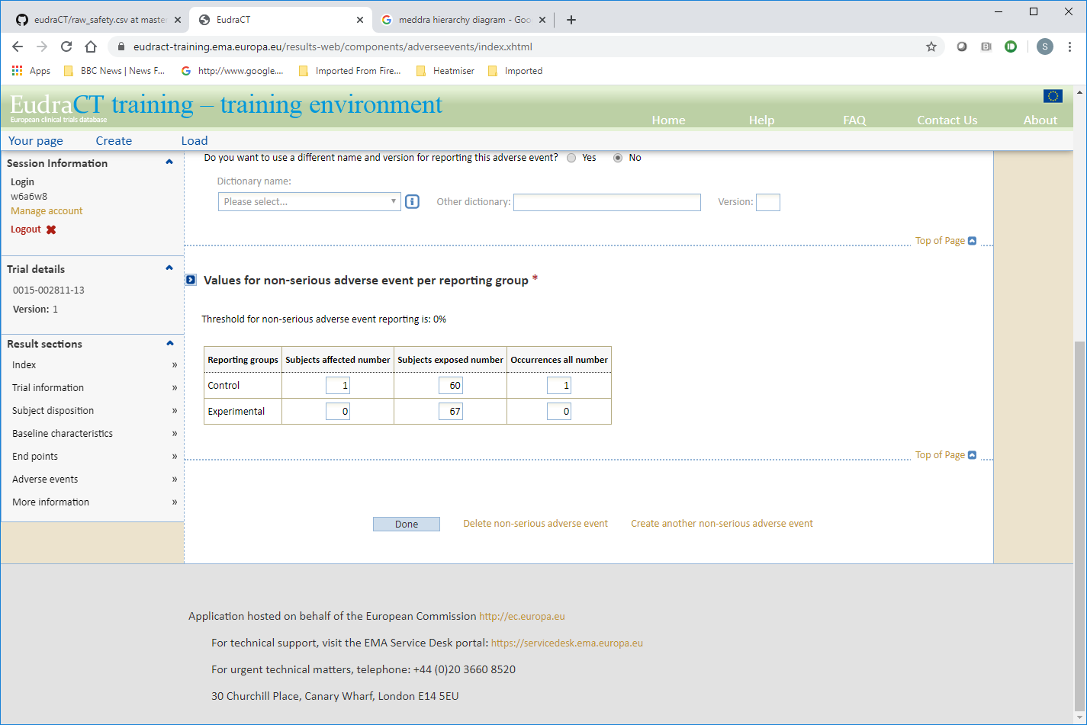
Output – Non Serious AE (part 2)

Slide 11
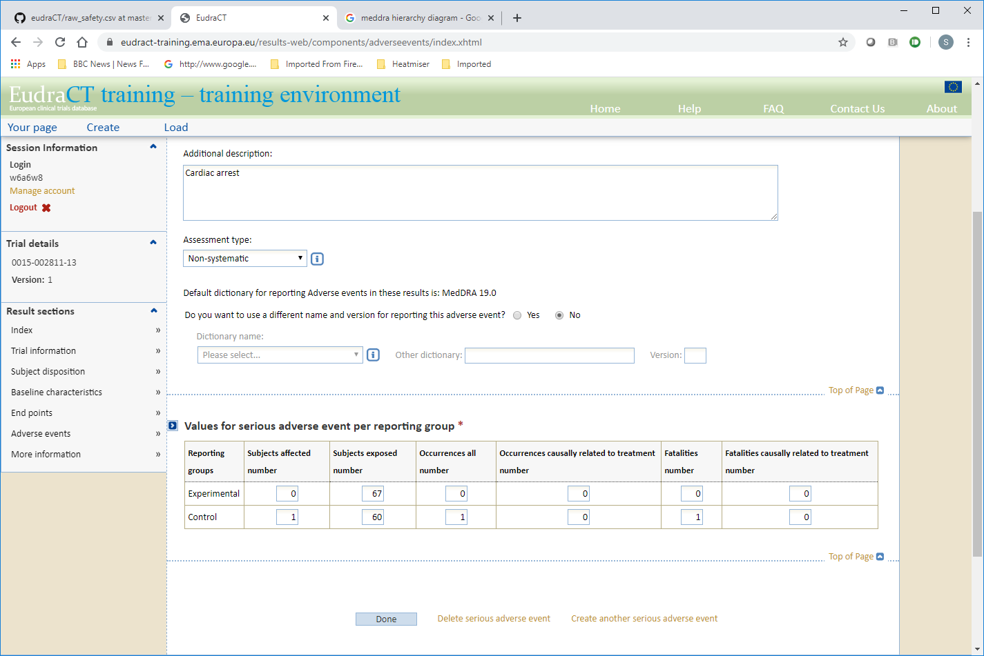
Output- Serious AE

Slide 12
Website – http://eudract-tool.medschl.cam.ac.uk
Downloads
Example
Github Repository link
Documentation
Manuals
FAQ
Testing
Feedback

Slide 13
Interactive Session
R
SAS
Stata (limited experience)

Slide 14
R
setwd("V:/STATISTICS/NON STUDY FOLDER/Staff/Simon")
library(eudract)
help(package="eudract")
head(safety)
?safety_summary
vignette("eudract")
safety_stats <- safety_summary( safety, exposed=c("Experimental"=60,"Control"=67))
safety_stats
?simple_safety_xml
simple_safety_xml(safety_stats, file="simple.xml")
readLines("simple.xml", n=10)
?eudract_convert
eudract_convert(input="simple.xml",
output="eudract.xml"
)
readLines("eudract.xml", n=10)

Slide 15
SAS
Safety_summary.sas
Statistical – Lines 1-270
Simple XML output – Lines 274-289
XSLT transformation – Lines 291-296

Slide 16
Stata
Safety_scriptv0.2.do
Statistical & XML output – Lines 1-220
XSLT transformation – Lines 224-228

Slide 17
Logic – Part 1
Read in data
Group stats
1 row per patient – any serious, non serious,…
Sum over each group
Add in the excess deaths
Give the correct variable names/ labels

Slide 18
Logic Part 2: Serious & Non-serious
Check if there are any events – if not use a blank template (SAS, Stata)
For each observed Term+SOC, need counts for every group
Count up occurrences and subjects - Both
Also count up related, fatal, related&fatal – Serious only
Merge back in the SOC code – eutctId
Filter by threshold < AE rate (Non-serious only)
Give the correct variable names/ labels

Slide 19
Github
Keeps track of changes over time
Seamless sharing through a website <-> local machine
Allows suggestions and edits to be made by anyone
Improve the Stata code ??

Slide 20
XML, XSLT, XSD
You don’t need to understand these
Quick Overview

Slide 21
XML Basics - Example
<?xml version ="1.0" ?>
<table cols="3">
<row> <subjid>1</subjid> <age>43</age> <sex>male</sex></row>
<row> <subjid>2</subjid> <age>13</age> <sex>female</sex></row>
<row> <subjid>3</subjid> <age>40</age> <sex>male</sex></row>
</table>
eXtensible Markup Language
Meta-rules for storing data
Tags – must be open and closed . Arbitrary what they are called
Respect nesting
Allow attributes – cols=“3”
Can view in any text editor, browser, or specialist xml tool.

Slide 22
XSLT – transforming the content
XSLT (Extensible Stylesheet Language Transformations) is a language for transforming XML documents into other XML documents, or other formats such as HTML for web pages, plain text or –Wikipedia
Need a processor to apply an XSLT script to an XML doc.
R, SAS have in-built processor
free MS processor available to call from Stata

Slide 23
Example Part 1
<table cols="3">
<row> <subjid>1</subjid> <age>43</age> <sex>male</sex></row>
<row> <subjid>2</subjid> <age>13</age> <sex>female</sex></row>
<row> <subjid>3</subjid> <age>40</age> <sex>male</sex></row>
</table>
<subject>
<value>1</value> <value>2</value> <value>3</value>
</subject>
<gender>
<value>male</value> <value>female</value> <value>male</value>
</gender>

Slide 24
XSLT example – Part 2
<?xml version="1.0" encoding="UTF-8"?>
<xsl:stylesheet version="1.0"
xmlns:xsl="http://www.w3.org/1999/XSL/Transform">
<xsl:template match="/">
<subject>
<xsl:for-each select="table/row">
<value><xsl:value-of select="subjid"/></value>
</xsl:for-each>
</subject>
<gender>
<xsl:for-each select="table/row">
<value><xsl:value-of select="sex"/></value>
</xsl:for-each>
</gender>
</xsl:template>
</xsl:stylesheet>

Slide 25
XSD – A set of rules for an XML
XSD (XML Schema Definition), a recommendation of the World Wide Web Consortium (W3C), specifies how to formally describe the elements in an Extensible Markup Language (XML) document. It can be used by programmers to verify each piece of item content in a document. – Wikipedia
Means to check if your XML document will be accepted

Slide 26
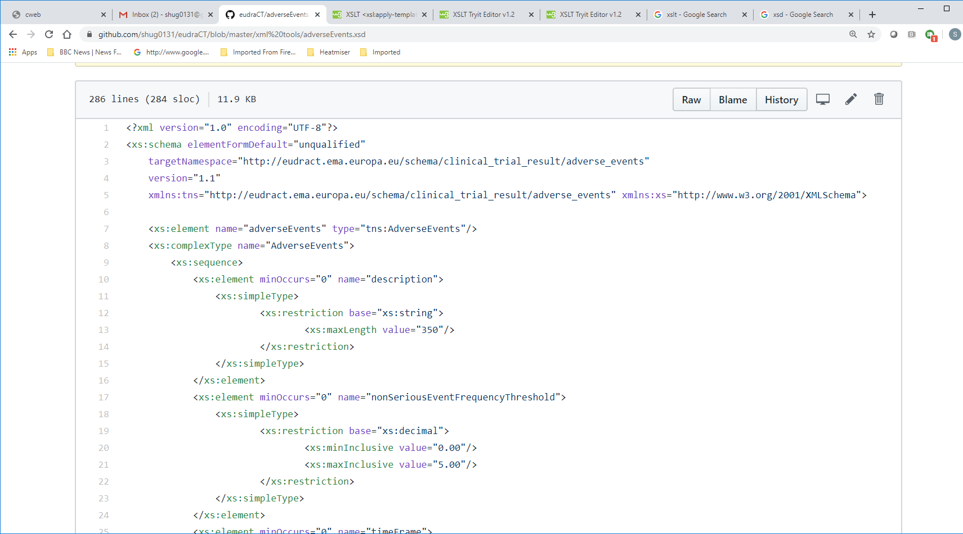
Rules for EudraCT AE data

Slide 27
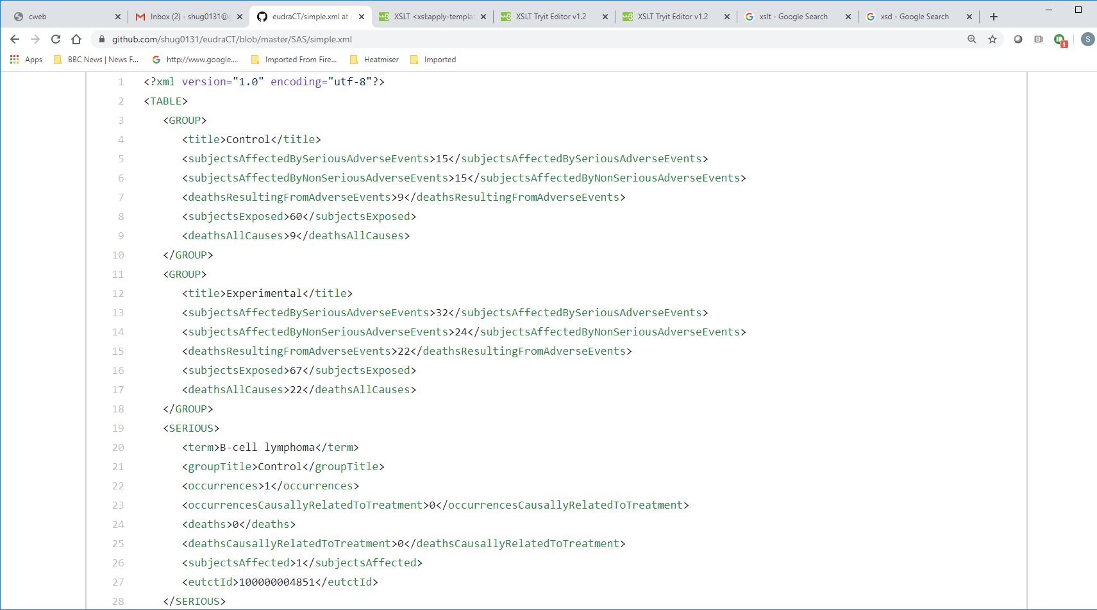
simple.xml -> simpleToEudract.xslt ->

Slide 28
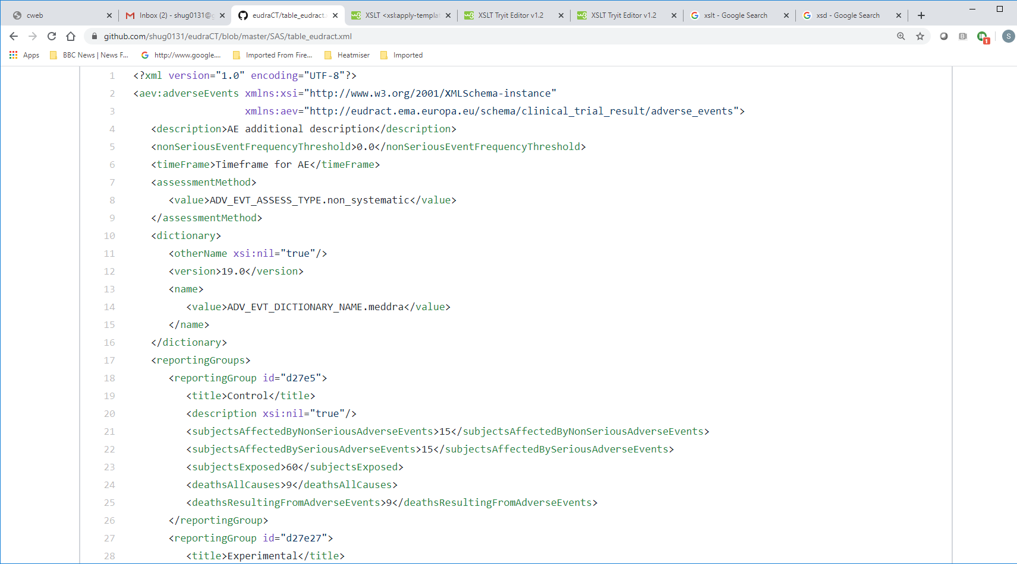
File to Upload

Slide 29
Upload Steps
https://eudract.ema.europa.eu/results-web/login/login.xhtml - the real thing
https://eudract-training.ema.europa.eu/results-web/ - training

Slide 30
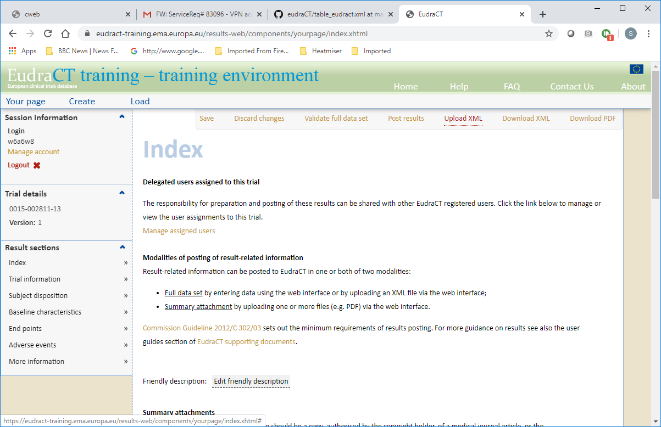

Slide 31
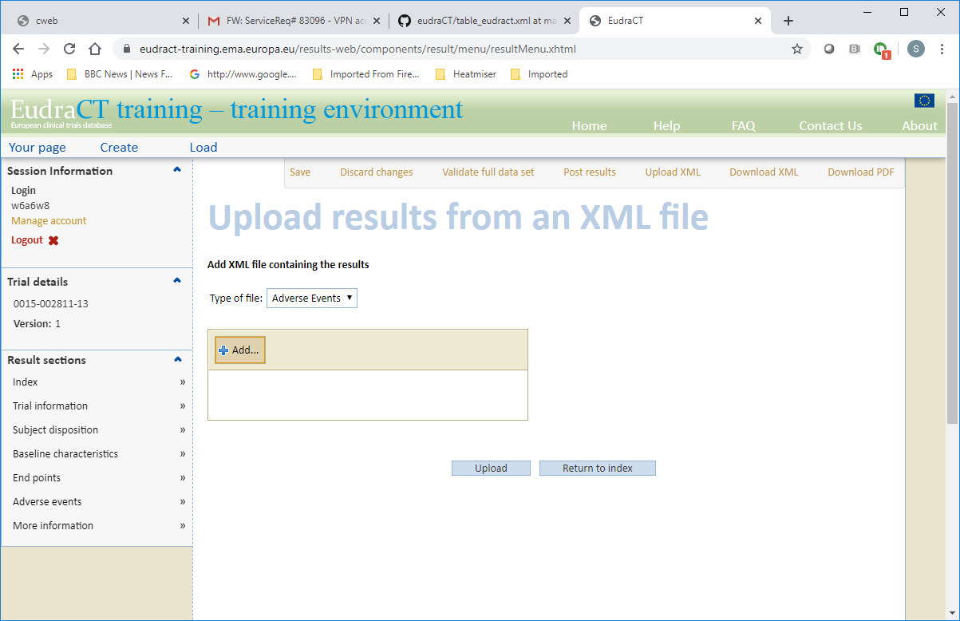

Slide 32
